Slide 1
Operating Systems
CST8101

Slide 2
The Importance of Operating System Software
Configuring a computer
- Device drivers allow computer to communicate with hardware devices
Customizing a computer
Displaying a user interface
Providing support services to applications
Handling input and output
Managing the file system
Working with folders and files
Managing system resources
- Multitasking

Slide 3
The Importance of Operating System Software
Resolving system errors and problems
Optimizing system performance
Backing up your computer
Power management
Computer and Internet security
- User account
Networking
Providing Help
- Wizards, demos, and Online Help
Notes:
User account also for profile

Slide 4
PC Operating Systems
Multitasking, task-switching, and multithreading
Document-oriented approach
Long filenames
Shortcuts
Plug and Play (PnP)
Backward compatibility
Notes:
Thread – unit of code
Document extension associated with app

Slide 5
PC Operating Systems Windows
Windows 9x product line
Windows 95
Windows 98
Windows ME
Windows NT Workstation 4.0
Advanced network operating system for companies and businesses
Windows 2000 Professional
Windows XP
Windows Vista
Windows 7
Windows 8
Windows 10

Slide 6
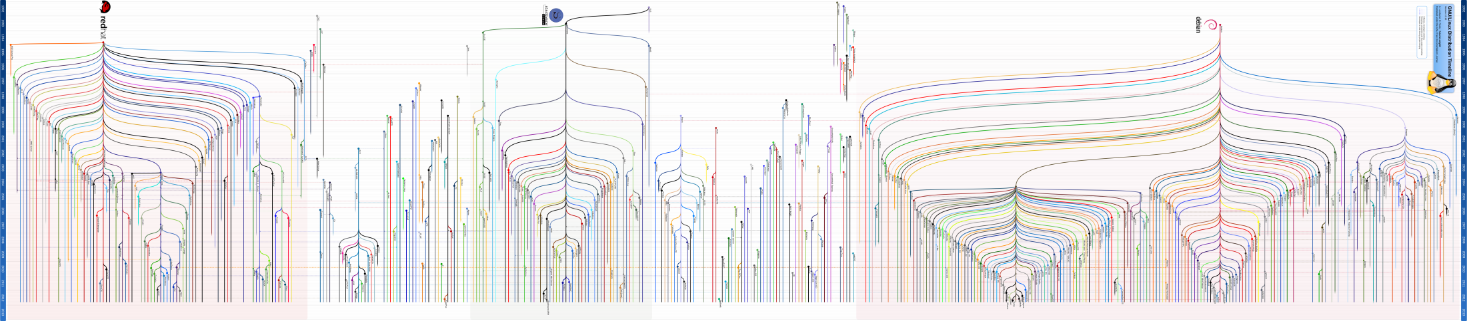
PC Operating Systems Linux
https://upload.wikimedia.org/wikipedia/commons/1/1b/Linux_Distribution_Timeline.svg

Slide 7
Operating System Concepts
Role of an O/S
Architecture of common desktop O/S
Plug and Play Concepts

Slide 8
Roles of an O/S
What does an O/S do?
Managing hardware resources
Manages software resources
Provides an interface for applications to interact with system without being aware of the specifics of the hardware.

Slide 9
Hardware Resources
An operating system treats a computer as a collection of resources
What’s a resource?

Slide 10
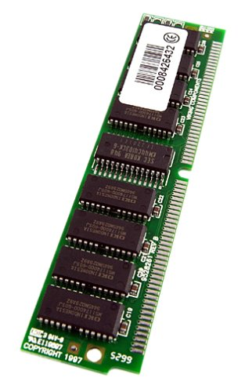
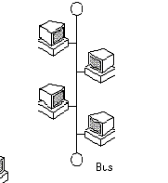

Hardware Resources
An operating system treats a computer as a collection of resources
What’s a resource?
Disk Space I/O System Memory

Slide 11
Hardware Resources
An O/S such as Windows manages numerous hardware components that may be allocated to a program or process
Such as …
DMA channels
IRQs
System Memory
Disk Space
…

Slide 12
Managing Hardware Resources - DMA
A PC provides eight DMA channels
These may assigned to devices which require DMA
For example ..
Storage devices (FDD, HDD, DVD, CD)
Sound Cards
O/S must
Assign channels
Resolve conflicts

Slide 13
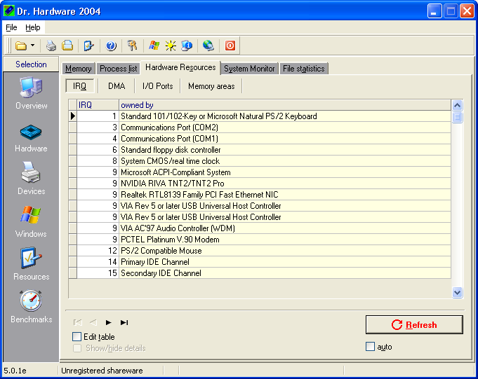
Managing Resources - IRQ
IRQ stands for “Interrupt Request”
Indicates a peripheral requires attention by the CPU
All devices trigger a common IRQ line on the CPU
CPU checks a buffer to determine number of IRQ
Identifies device requiring attention
O/S assigns IRQs, and manages conflicts

Slide 14
Managing Resources - Memory
In most operating systems, multiple tasks (processes) are running simultaneously
Each process is assigned various resources
A blocks of memory
System stack space
Timers
Semaphores
Etc

Slide 15
Managing Resources - Software
Operating System is essentially a traffic cop!
The Operating System will
Stop a process from accessing memory assigned to another process
Access Violation
Enforcing time limits for each running process
Preventing ‘runaway’ processes
Allowing processes to be started and terminated

Slide 16
Operating System - Overall
In General
Operating System is responsible for
Assigning system resources (IRQ, memory, disk)
Preventing conflicts (bus access, DMA channels)
Enforcing boundaries and limits (memory access violations, CPU time)
O/S Allows a system to function

Slide 17
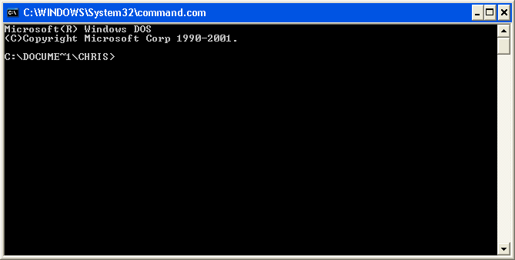
Types of Operating Systems
Single User, Single Thread
Only one user per system, one program at a time
Early O/S, e.g. MS-DOS

Slide 18
Types of Operating Systems
Multi-User, Multi-Thread
Permits multiple programs to run simultaneously
Permits multiple users to use the system simultaneously
Most common current desktop O/S
Windows, Linux, MacOS

Slide 19
Operating System
Operating System sets up any low-level software (such as device drivers) that are necessary for the device to be used by applications.
Also communicates with the user, notifying them of changes to the configuration
Allows changes to be made to resource settings if necessary

Slide 20
Logging Off, or Turning Off, Your Computer
Windows 7 provides the following options for shutting down your computer or logging off your user account
Shut Down
Log Off
Lock
Restart

Slide 21
Logging Off, or Turning Off, Your Computer
Sleep
Hybrid Sleep
Hibernate
Hibernation file
Switch User

Slide 22
File Management
Is the process of organizing digital files, creating new folders, and being able to navigate through the folder structure of your computer.
Notes:
File management is the process of organizing digital files, creating new folders, and being able to navigate through the folder structure of your computer. It is an important skill needed when working with computers.

Slide 23
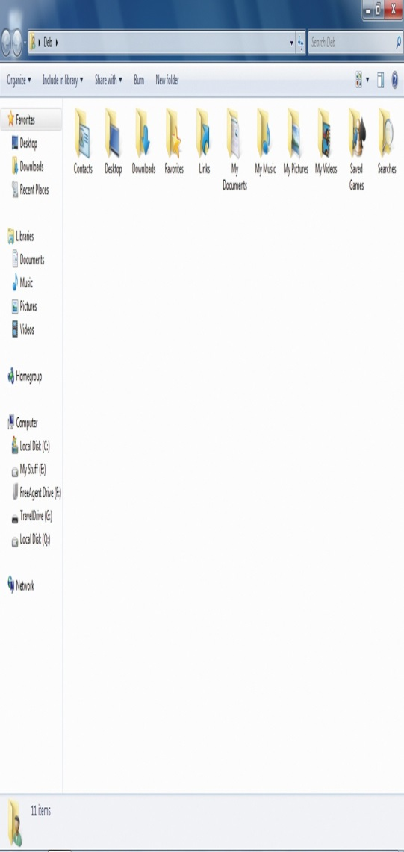
File Management
Folders are containers used to organize files on your computer.
By default, Windows comes with certain files and folders already created.
You can access the Users Folder by the Windows Start menu or the desktop
The folder structure created by Windows is a hierarchy.
Notes:
The folder structure created by Windows is a hierarchy. Folders are containers used to organize files on your computer. By default, Windows comes with certain files and folders already created. You can access the Users Folder by the Windows Start menu or the desktop.

Slide 24
Libraries
Library can display files that are stored in several folders at the same time. It is an access point to folders and files

Slide 25
Anatomy of a File Name
ch03_homework.docx
FILE NAME
EXTENSION
Test.sys
Notes:
Here is an example of a file: ch03_homework is the name of the file. The file extension is .docx, which tells Windows that it is a Microsoft Word 2010 document.

Slide 26
Navigating Your Computer
Valid vs Invalid filenames
Valid file names include:
Space, number sign, dash, ampersand, upper and/or lower case, accented, more than one period, no extension, dashes, numbers, parentheses, the “at” symbol
Invalid filenames include:
Reserved names, colon, forward or back slash, asterisk, quotation marks, question mark, chevrons, pipe symbol
:\ / * ” ? > < |

Slide 27
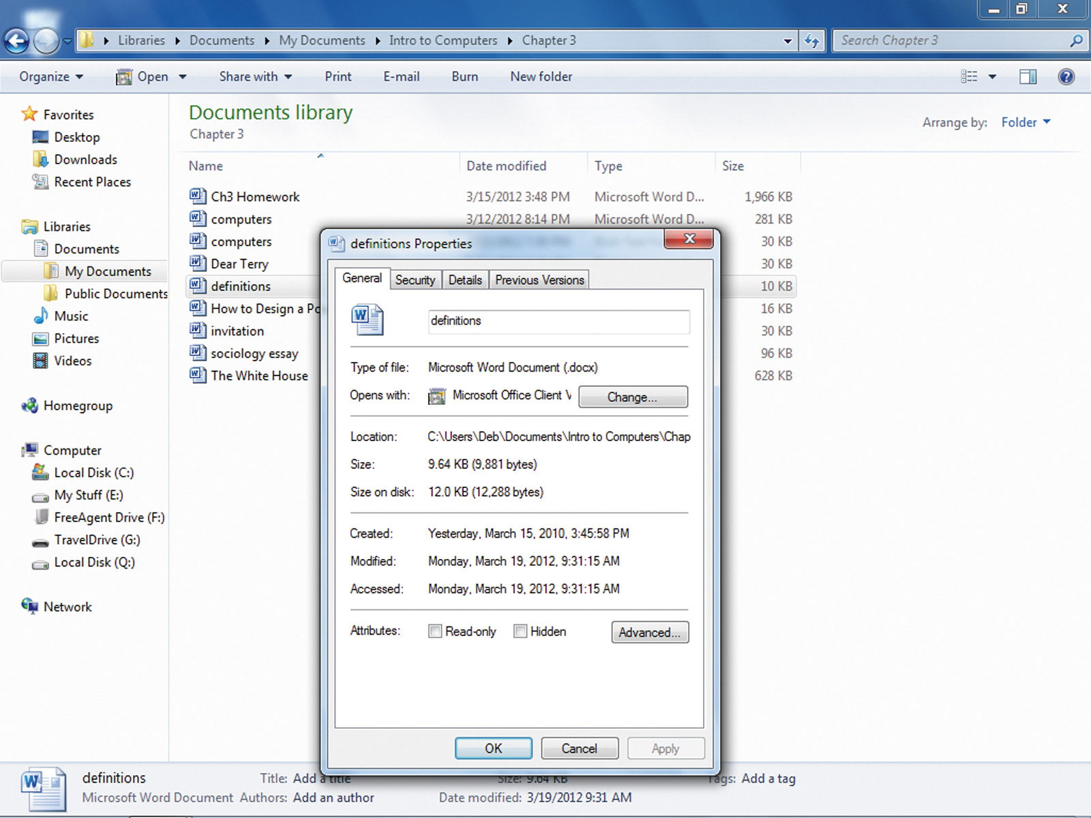
File Properties
We can use these properties to organize, sort, and find files more easily
File type, size, and date are automatically created
Title and author can be added or edited by the user
The Properties dialog box contains a lot of information about the file
Notes:
File properties are the characteristics associated with the file. Each file includes file properties. We can use these properties to organize, sort, and find files more easily. File type, size, and date are automatically created. The title and author can be added or edited by the user. The Properties dialog box contains a lot of information about the file.

Slide 28
What is file attribute?
A file access classification that determines how a file can be viewed or whether it can be edited
Command for file attribute: attrib
ATTRIB [+R | -R] [+A | -A] [+S | -S] [+H | -H] filespec [/S]
+ Sets an attribute.
- Clears an attribute.
R Read-only file attribute.
A Archive file attribute.
S System file attribute.
H Hidden file attribute.

Slide 29
How to:
Create Folders
Create Sub-folders
Create Files
Copy Files
Move Files
Delete Files

Slide 30
Shortcuts
CTRL+X: Cut
CTRL+C: Copy
CTRL+V: Paste
CTRL + Z: undo
CTRL + A: Select all
CTRL+ ESC: Display the Start menu
ALT+TAB : Switch between the open items)
ALT+ESC (Cycle through items in the order that they had opened
ALT+ENTER: Open the properties for the selected object been opened)
ALT+SPACEBAR :Display the System menu for the active window

Slide 31
Shortcuts
ÿ + E: Open File Explorer
ÿ + R: Open the Run Menu
ÿ + L: Lock the Computer
ÿ + M: Minimize all windows
ÿ + P: Multi-Display Mode
ÿ + D: Show the Desktop
ÿ + <TAB>: Aero Flip
ÿ + <Space>: Aero Peek

Slide 32
Software Interaction
How does software interact with an operating system?
The operating system provides an Application Program Interface (API)
API is a common interface for interacting with hardware, and O/S functions
Allows designers to not be concerned with the inner workings of a peripheral, or the O/S

Slide 33
API – An Example
Typically and API is presented to a designer as skeleton procedures and procedure calls
Example : Designing a plugin for the Netscape Web Browser
RealPlayer, Shockwave, etc.
// CPluginArgs.h
#ifndef CPLUGINARGS_H
#define CPLUGINARGS_H
#include "CNetscapeMemObject.h"
class CArgumentNode : public CNetscapeMemObject {
public: CArgumentNode( char* adoptArgumentName, char* adoptArgumentValue );
virtual ~CArgumentNode();
const CArgumentNode* FindArgumentByName( const char* normalArgName ) const;
const char* GetArgumentName() const;
const char* GetArgumentValue() const;
void AdoptChildArgument( CArgumentNode* adoptedArg );
private:
char* fArgumentName;
char* fArgumentValue;
CArgumentNode* fLesserChild;
CArgumentNode* fGreaterChild;
};

Slide 34
Windows APIs
Windows APIs allow software designers access to numerous system resources, such as
Manipulating files
Allocating memory
Interacting with other processes
Accessing system buses

Slide 35
The Dynamic Link Library
The Dynamic Link Library (DLL) is the most common implementation of a Windows API
Represents a set of executable routines which may be accessed by applications

Slide 36
Examples of Windows APIs
From library : kernel32.dll
Provides such functions as …
CopyFile ("C:\MyStuff\temp.txt", C:\Junk\buffer.txt", 1)
CreateDirectory("C:\Dummy\NewDir", secattr)
EnableWindow (Command1.hWnd, 0)

Slide 37
Examples of Windows APIs
Icon Manipulation
From library : user32.dll
DrawIcon(Form1.hDC, 100, 75, hIcon)
DestroyIcon(hIcon)

Slide 38
Additional API Services
Windows APIs provide standard error and return codes
Simplifies analyzing the results of API procedure calls
Typical Windows Codes …
ERROR_SUCCESS
ERROR_INVALID_FUNCTION
ERROR_PATH_NOT_FOUND

Slide 39
Further API services
Provides a means of identifying hardware and hardware manufacturers
Standardizes structure of Plug-and-Play (PnP) interfaces
PnP allows a PC to automatically configure cards and other peripherals

Slide 40
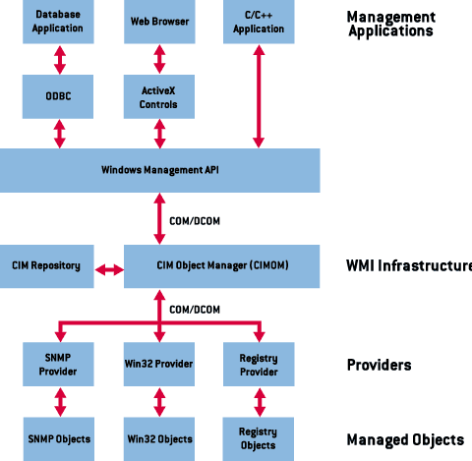
Typical API Architecture
Applications
Applications APIs
Windows API
Windows
Internals

